Slide 1
AUTOMATED DIABETIC RETINOPATHY DETECTION AND GRADING USING DEEP LEARNING
Mentor: Dr. Lavanya R
Kshitij Zutshi
CB.EN.U4EIE14026

Slide 2
OBJECTIVES
Create an automated CAD diagnostic system
Classifications done based on deep learning techniques
To create a multi class classification to determine stage of disease - GRADING
Grading of diseases enables one to determine course of action to be taken in order to minimise damage caused by disease.

Slide 3
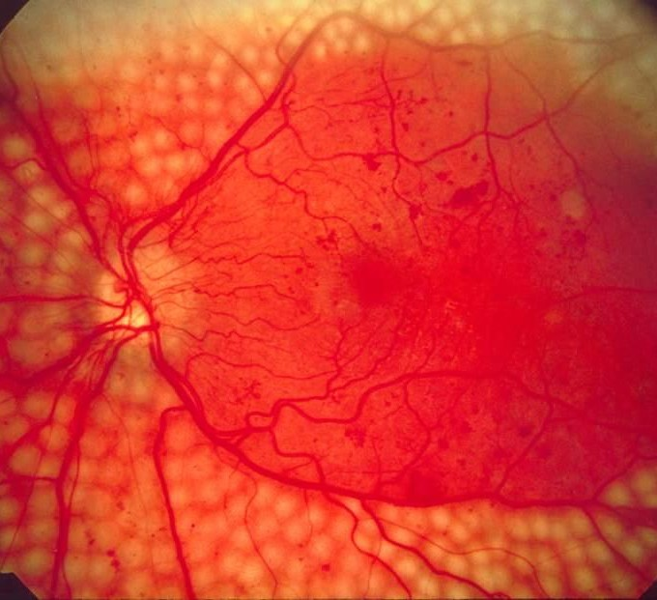


What is Diabetic Retinopathy RrdfedfRRetinopathy
Diabetic retinopathy is a diabetes complication that affects eyes. It's caused by damage to the blood vessels of retina.
EFFECTS
MACULAR EDEMA-
In which retinal blood vessels develop tiny leaks.
VITREOUS HEMORRHAGE-
Where abnormal blood vessels begin to grow on the surface of your retina.
Notes:
As you can see in the slide shown

Slide 4
STAGES OF Diabetic Retinopathy
Diabetes without Retinopathy Preproliferative Retinopathy Proliferative retinopathy
Widespread bleeding and vision blurring detected.
High risk of permanent damage.
Treatments-laser treatment, eye injections.
Formation of blood vessels and scar tissues
Patchy vision
Does not affect eye sight
Microaneurysms in retina
Consultation of ophthalmologist recommended.
Treatment- Eye injections , Surgery if Maculopathy Detected

Slide 5
Stage -1 Diabetes without Retinopathy
It is dictated by Underlying Pathology and not the Clinical Presentation.
Hyperglycemia/high blood sugar levels - causes damage to cells called Pericytes which regulate the blood flow in the Brain.
The diagnosis in this stage is possible by fundus images with ease.

Slide 6
Stage -2 Non (pre-) Proliferative Diabetic Retinopathy
The damage to the pericytes in stage 1 causes the weakening of the capillary walls.
This forms Microaneurysms which are the focal dilations of the weakened blood vessel walls. [First clinical sign - Red dots ]
Damage to Pericytes causes increase in Vascular Permeability ie., Capillaries become leaky.
These leaks allow large molecules of lipids and proteins formation in retina.
Yellow flakes of such formations Hard exudates
2nd stage
Clinical findings

Slide 7
Stage -3 Proliferative Diabetic Retinopathy
Can be asymptomatic, its uncommon and most individuals that reach this stage of DR usually have at least Blurry vision or presence of floaters.
Characterised by :
Vascular Proliferation within the retina.
The microvascular damage that occurs in 1st and 2nd stage of DR,
Results in ischemia (lack of blood supply to tissues) and Hypoxia.
At this stage the diagnosis can be examined on a dilated eye exam.

Slide 8


Slide 9
ORIGIN- Why Diabetic Retinopathy?
DR is the leading cause of vision loss in working-age adults so it has profound economic consequences from lost productivity and the cost of ongoing care.
Approximately one in three people living with diabetes have some degree of DR and one in 10 will develop a vision-threatening form of the disease
Damage to the retina is often irreversible in the later stages of the disease and results in blindness.

Slide 10
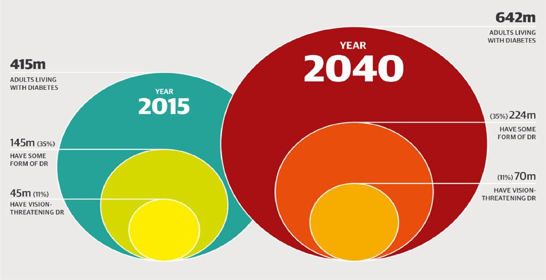
STATISTICAL DATA PROVIDED BY IAPB Vision Atlas

Slide 11
Need for CAD?
“ Improved accuracy and overall system performance”

Slide 12
MOTIVATION?
Automated CAD system reduces the cost of diagnosis
Reduces the human resource required in disease diagnosis, Hence increasing accessibility to general population
Reduces ambiguities -- Two doctors need not give same diagnosis.

Slide 13
Fundamental Steps in Automated Analysing system :
Blood Vessels extraction
Microaneurysms
Hemorrhages
Exudates
Optic Disk ( Cup to disk Ratios.,)
Fovea (Area of high concentration of cones in retina)

Slide 14
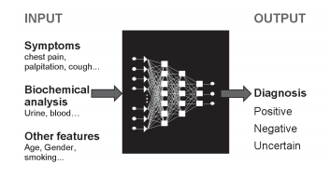
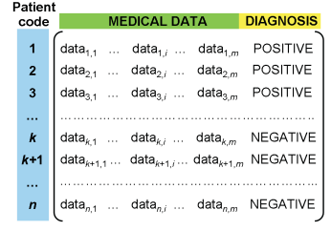
ANN In Medical Diagnosis
Example of training database structure. Each row refers to a different patient labeled with a numerical code. The element datak,i refers to the i-th medical data (symptom, laboratory data, etc.) of the k-th patient.
Details of input and output items concerning ANNs-based diagnosis (ANN architecture is often hidden and it is indicated here as a black box

Slide 15
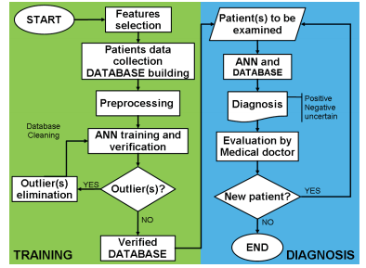
Fundamental Steps in ANNs based Medical Diagnosis
The major steps can be summarized as:
Features selection
Building the database
Data cleaning and preprocessing
Data homoscedasticity(data with same Varience)
Training and verification of database using ANN
Network type and architecture
Training algorithm
Verification
Robustness of ANN-based approaches
Testing in medical practice

Slide 16
Conclusions
ANNs represent a powerful tool to help physicians perform diagnosis and other enforcements. In this regard, ANNs have several advantages including:
The ability to process large amount of data
Reduced likelihood of overlooking relevant information
Reduction of diagnosis time
Convolutional neural networks allow networks to have fewer weights and they are given a very effective tool - convolutions - for image processing.
For instance, we know that images contain a lot of redundant information, and that for object recognition, edges are often all we need. We have used this insight to give the neural network a simple way to do edge detection, though convolution.

